Slide 1


ENGLISH LEVEL B1 - II
Lesson 04
TALKING ABOUT DIFFERENT CULTURES
Notes:
Teacher’s Notes:
Explain the lesson goal: learning words and sentences related to hospitals.
Ask students: Have you ever been to a hospital? Why?

Slide 2

01
Students will be able to talk about different cultures using comparative adjectives and the past continuous tense
ENGLISH LEVEL B1 - II

Slide 3
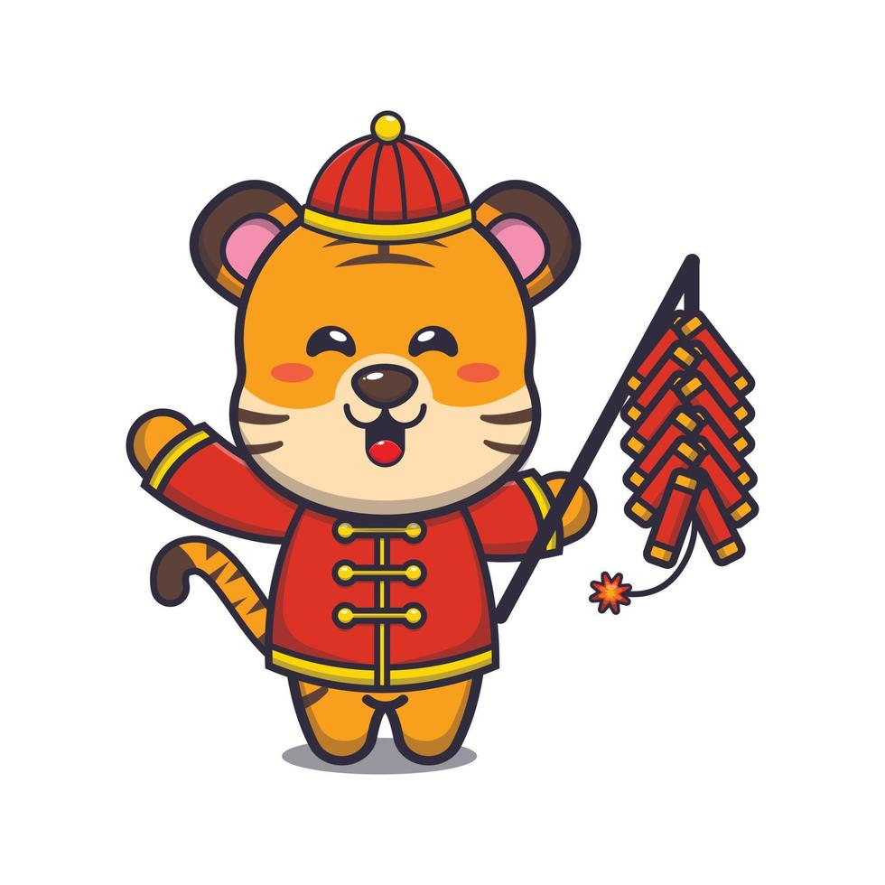
TALKING ABOUT DIFFERENT CULTURES
EXPLORING DIFFERENT CULTURES
Look at the picture and answer the questions:
1
What do you see in the picture?
2
Have you ever participated in a cultural event different from your own?
3
Why is it important to learn about other cultures?
4
What is a unique tradition from your country?

Slide 4
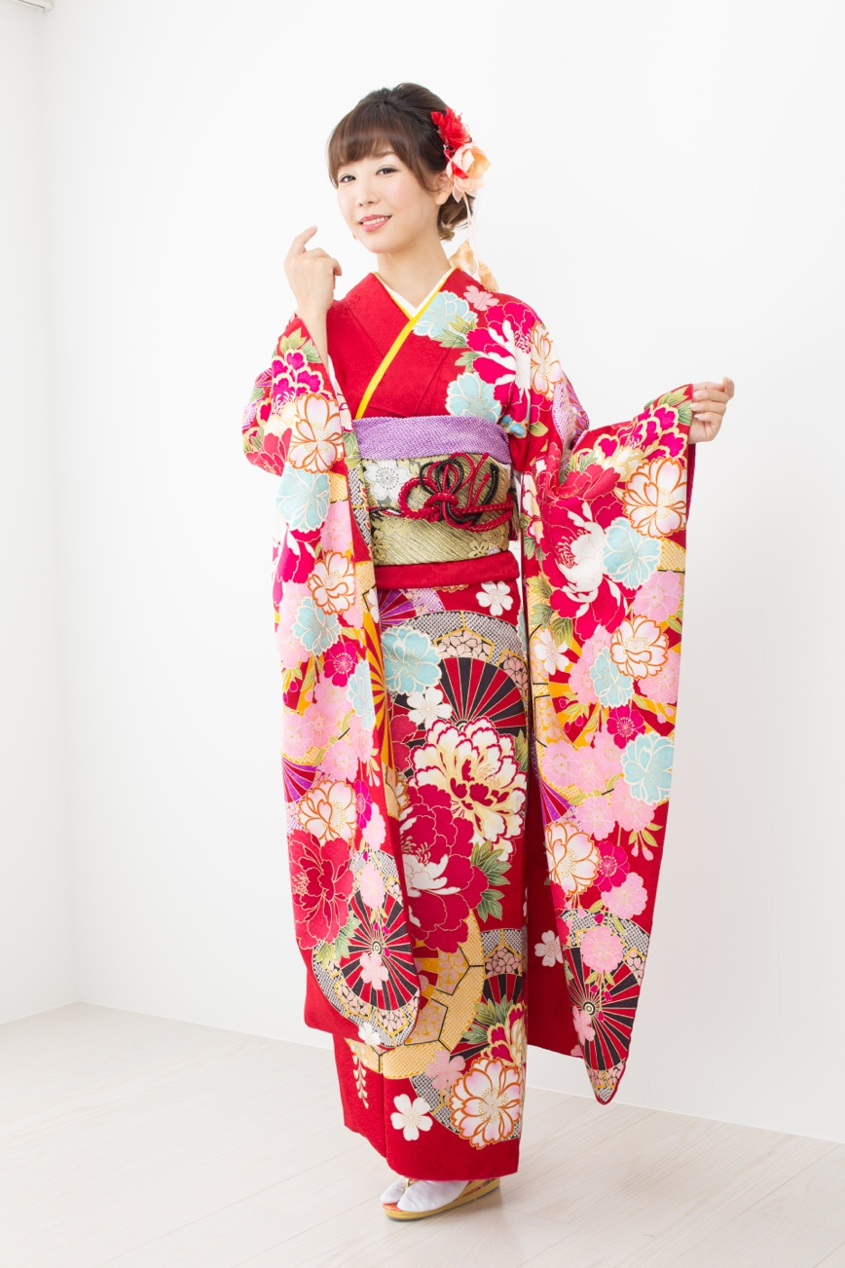
TALKING ABOUT DIFFERENT CULTURES
DESCRIBING CULTURAL TRADITIONS
Vocabulary List:
Festival Tradition, Custom, Food, Clothing, Music
Exercise: Complete the sentences using the words from the vocabulary list.
In India, people celebrate the Diwali ______.
A _______ in Mexico is eating tamales for Christmas.
Each country has its own traditional ______, like wearing a kimono in Japan.
The most famous ______ in Brazil is Samba.
Thanksgiving is a _______ where people eat turkey and pie.

Slide 5
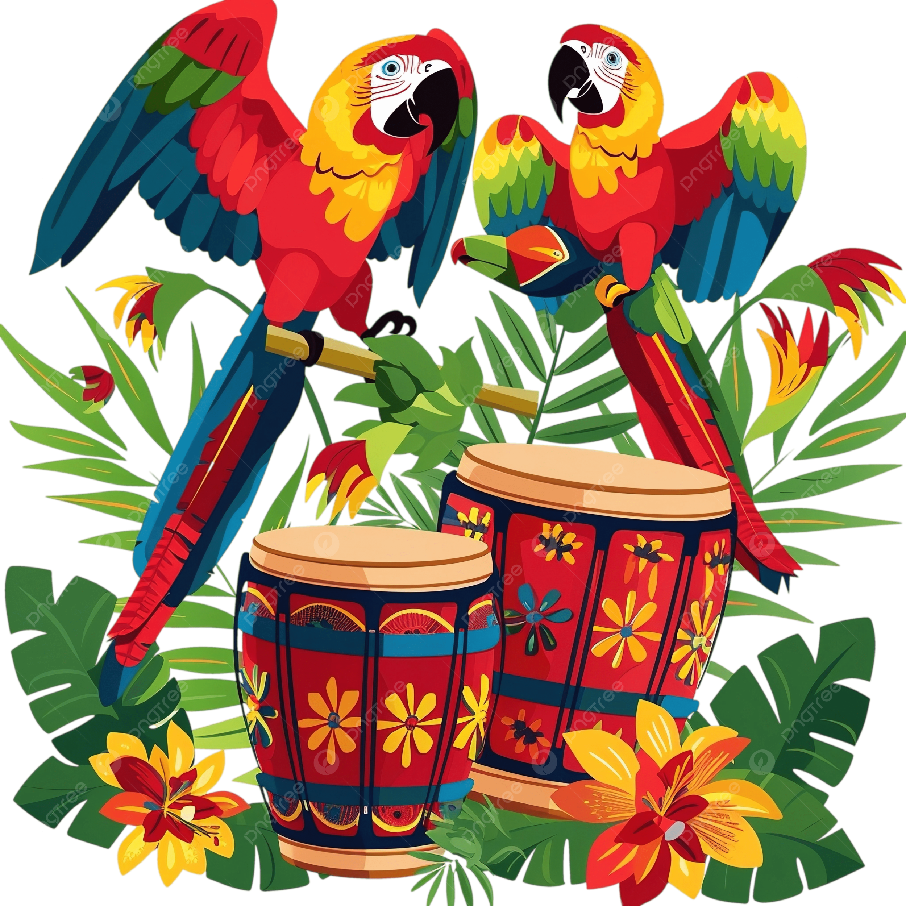
TALKING ABOUT DIFFERENT CULTURES
COMPARING CULTURAL CELEBRATIONS
Exercise: Complete the sentences using comparative adjectives.
Chinese New Year is ______ (colorful) than Thanksgiving.
African drumming is ______ (loud) than European classical music.
Carnival in Brazil is ______ (big) than local parades.
The food in Italy is ______ (tasty) than fast food.
Wearing a kimono is ______ (formal) than wearing jeans.

Slide 6
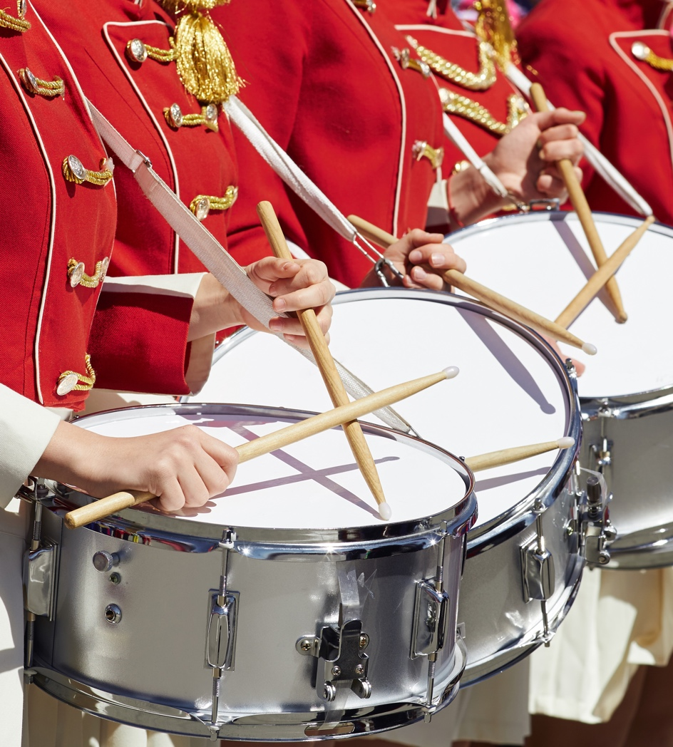

TALKING ABOUT DIFFERENT CULTURES
TALKING ABOUT CULTURAL ACTIVITIES IN THE PAST
Exercise: Complete the sentences using the past continuous form of the verbs in parentheses.
During the festival, people __________ (wear) traditional clothing.
At the parade, musicians __________ (play) drums and guitars.
While the chefs __________ (prepare) the special dish, guests arrived.
The audience __________ (watch) a traditional dance performance.
At the cultural fair, children __________ (learn) how to make handicrafts.

Slide 7
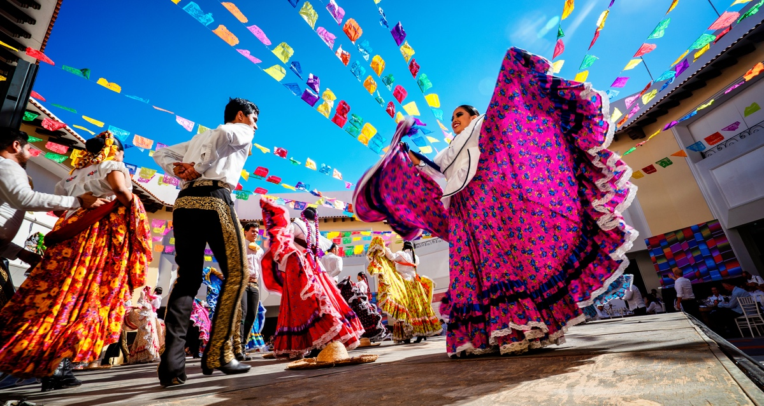
TALKING ABOUT DIFFERENT CULTURES
Pair activity
After completing the sentences, discuss with a partner:
Have you ever seen or participated in a cultural festival? What were people doing?
Write 3 sentences using the past continuous.

Slide 8
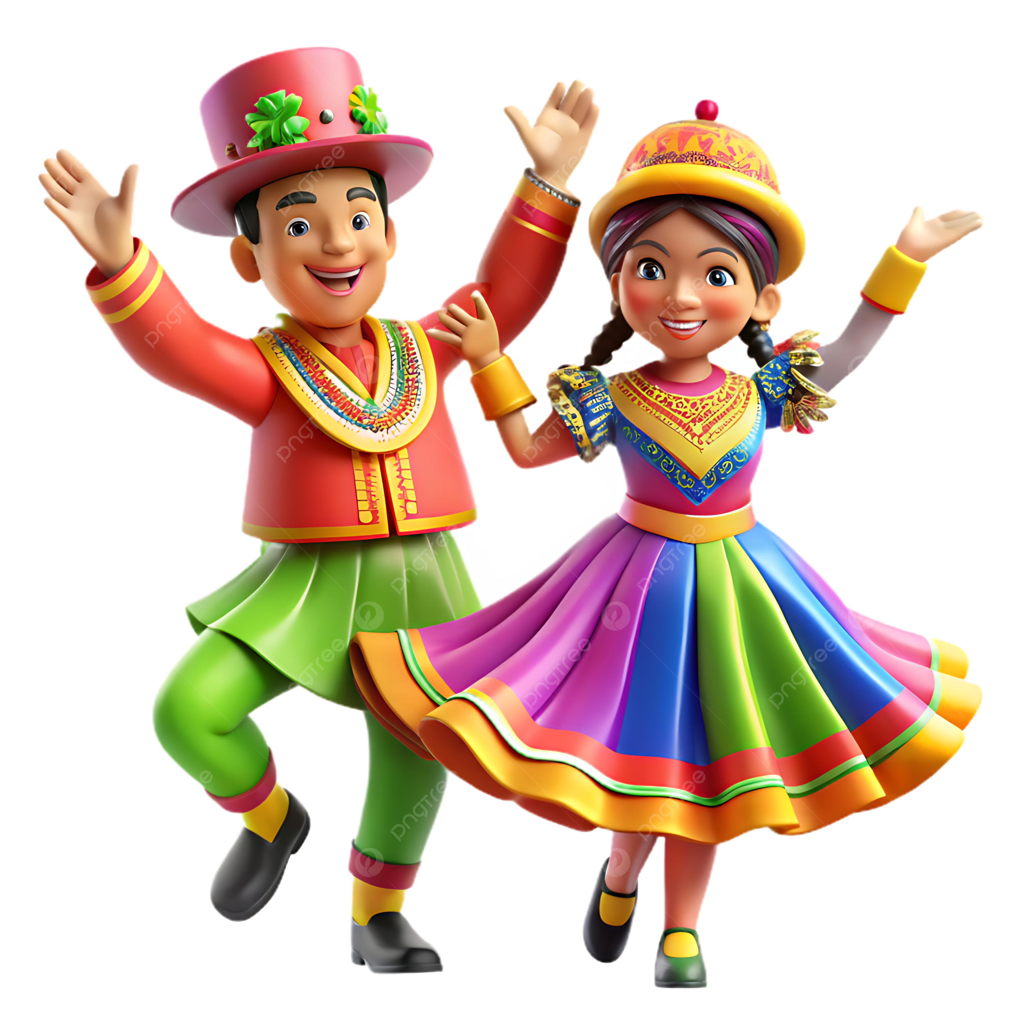
TALKING ABOUT DIFFERENT CULTURES
USING PAST CONTINUOUS TO DESCRIBE EVENTS
Exercise: Rewrite the sentences in the past continuous.
He ate a traditional meal. → He _______ a traditional meal.
They sang at the festival. → They _______ at the festival.
She wore a beautiful costume. → She _______ a beautiful costume.
We watched a parade. → We _______ a parade.
People danced in the street. → People _______ in the street.

Slide 9
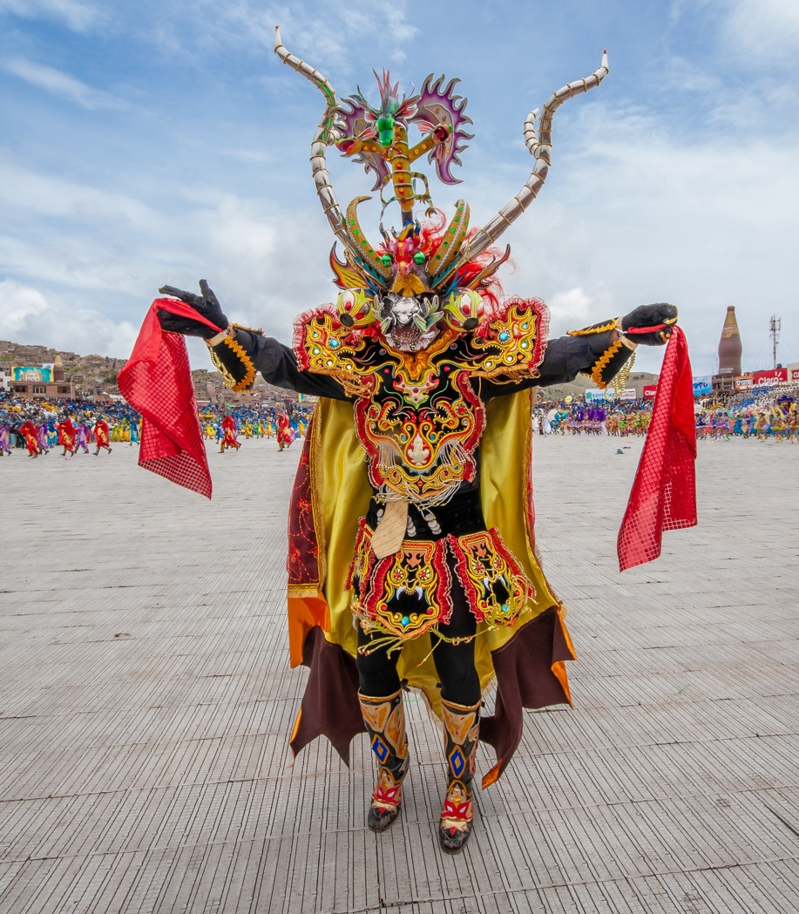
TALKING ABOUT DIFFERENT CULTURES
WH-QUESTIONS ABOUT
Exercise: Answer the WH-questions using complete sentences.
What is a special holiday in your country?
Where do people celebrate this event?
When does it happen?
Why is it important?
How do people celebrate it?

Slide 10
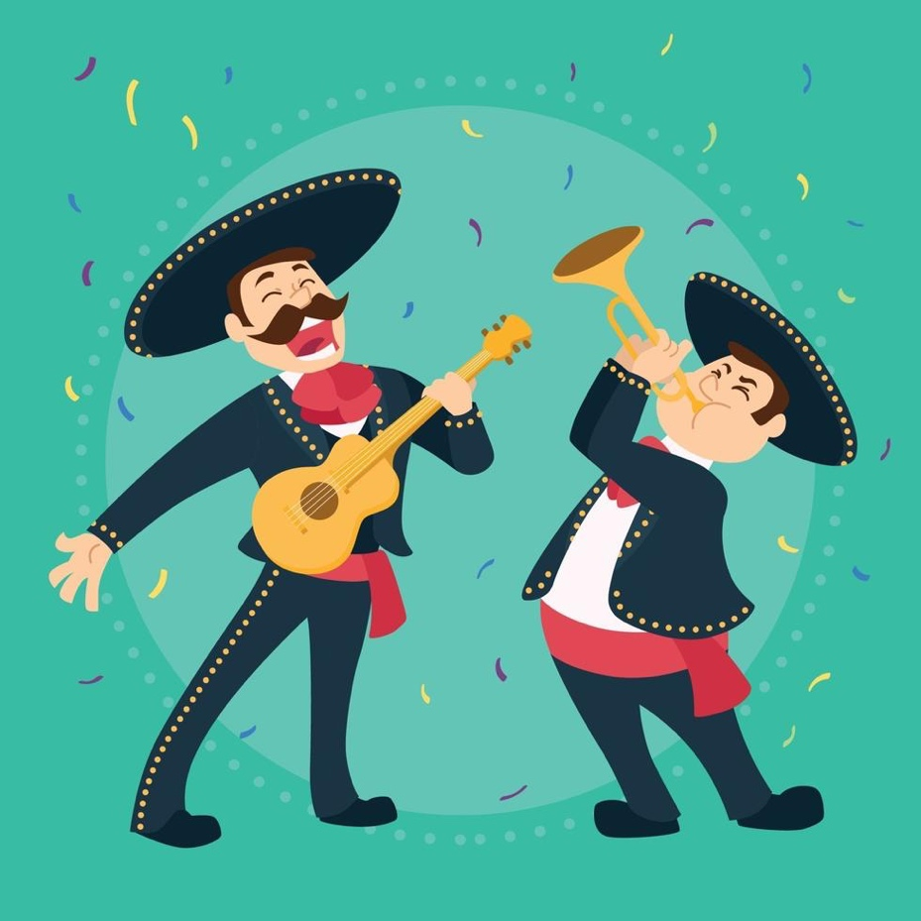
TALKING ABOUT DIFFERENT CULTURES
Describing Cultural Differences
Instructions:
Write five sentences comparing two cultural aspects using the comparative form of the following adjectives:
✔ Modern, Famous, Simple, Peaceful, Friendly
Example Sentences:
Traditional music is simpler than modern music.
Cities are usually busier than small towns.

Slide 11
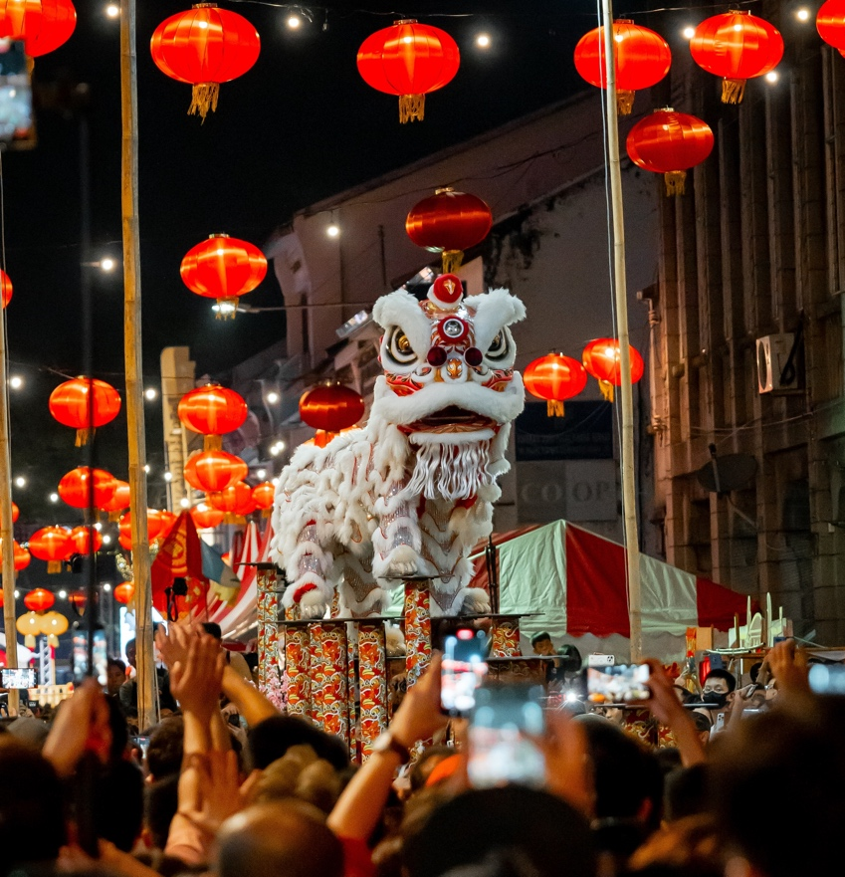
TALKING ABOUT DIFFERENT CULTURES
CHECKING UNDERSTANDING
Quick Quiz:
What is the difference between a tradition and a custom?
Give an example of a festival with music.
Change the sentence: "He wore a traditional hat." → (Past continuous)
Complete: "Chinese New Year is ______ (exciting) than my birthday."
What WH-question asks about "reason"?

